Slide 1
BOX JUMPER!
RYAN BOYD
JEROMY BAMO
CS-380 PROJECT
DR. SWANSON

Slide 2
HOW TO PLAY:
OBJECTIVE:
Obtain a high score by jumping over the bricks.
HOW THE GAME WORKS:
Jump over the bricks to stay alive.
If the player runs into a brick, the game is over.
The score system is based on time played in seconds.

Slide 3
HOW TO START
BOX JUMPER

Slide 4
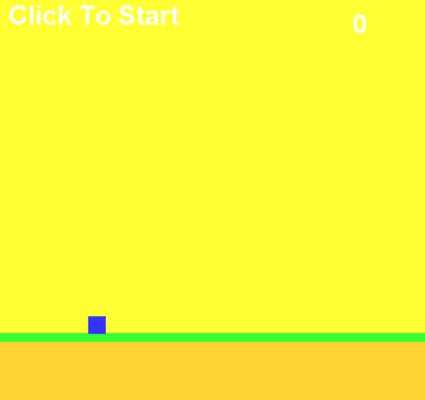
Launch the game and make sure the brick.png is on the desktop.
Next you will see on the top left corner “Click To Start.”
* Once your score is higher than 1, the “Click To Start” will go away.
Press the spacebar in order to jump over the bricks.

Slide 5
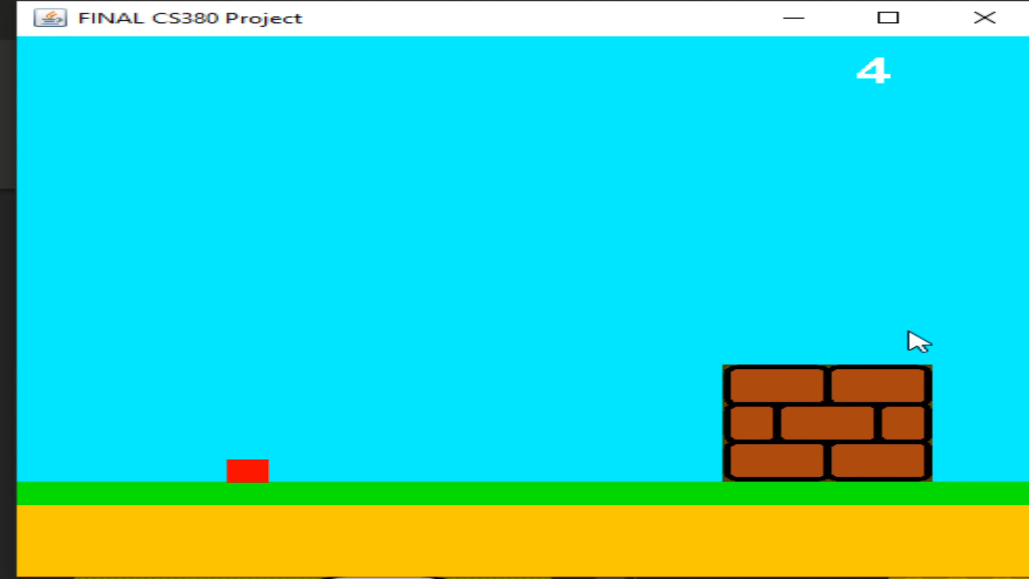
GETTING THE SCORE!
Avoid the brick by pressing the spacebar to jump over them.
You can also use your mouse by clicking to jump over the bricks.

Slide 6
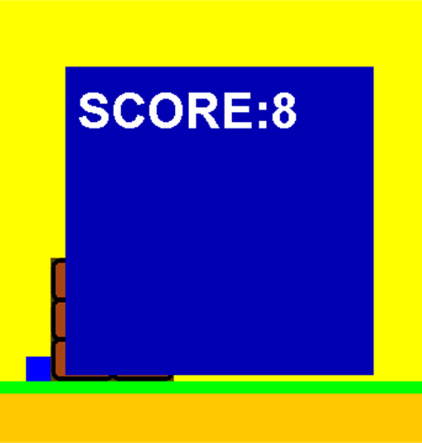
game
OVER!
If you run into a brick, the game will be over.
Score will be displayed on the screen.

Slide 7
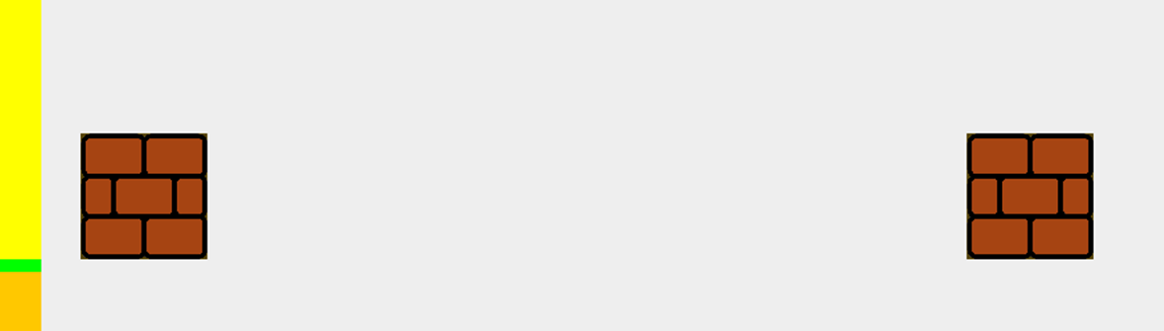
ADDITIONAL INFORMATION:
The space between every brick is randomized. Please be sure to pay attention because if you jump too early or too late, the game may be over.

Slide 8
CODE EXPLANATION

Slide 9
CODE EXPLANATION cont…

Slide 10
LIVE
DEMONSTRATION

Slide 11
QUESTIONS?
COMMENTS?
CONCERNS?

Slide 12
You can also split your content
White
Is the color of milk and fresh snow, the color produced by the combination of all the colors of the visible spectrum.
Black
Is the color of ebony and of outer space. It has been the symbolic color of elegance, solemnity and authority.

Slide 13
In two or three columns
Yellow
Is the color of gold, butter and ripe lemons. In the spectrum of visible light, yellow is found between green and orange.
Blue
Is the colour of the clear sky and the deep sea. It is located between violet and green on the optical spectrum.
Red
Is the color of blood, and because of this it has historically been associated with sacrifice, danger and courage.

